Slide 1
Digital image processing and analysis 5. Image enhancement: global operations
Professor Ela Claridge
School of Computer Science

Slide 2
Previous lecture:
Digital representation of colour images
Colour mixing (vector arithmetics)
Pixel arrays
Colour models

Slide 3
In this lecture we shall find out about:
Image enhancement and restoration
Image histogram
Manipulating image brightness
Contrast enhancement
LUT operations

Slide 4
Image enhancement Scope
Elimination or significant reduction of image distortions caused by imperfect image generation process
Improvement of visual qualities of an image (brightness, contrast, sharpness, etc.)

Slide 5
Image enhancement Causes
Contrast distortions
Causes
exposure error
limited dynamic range of sensors
Geometric distortions (not covered in the lectures)
Causes
sensor or camera geometry
lens geometry (e.g. wide-angle)
object geometry (e.g. projection of the Earth)

Slide 6
Image enhancement Contrast enhancement: methods
Contrast enhancement
Exposure correction - statistical methods
“histogram manipulation”
Sensor distortion correction - camera model
“de-illumination”
Sharpening - filtering

Slide 7
Image enhancement Histogram
Histogram is a frequency distribution graph.
It shows the number of pixels in the image having a particular image value or a range of values.
Number of pixels
Pixel value

Slide 8

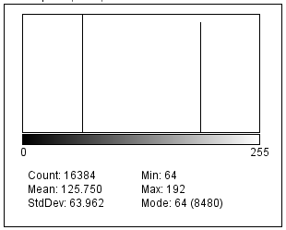
Image enhancement Histogram
Two images with the same statistical distribution of pixel values but with different spatial distribution of pixel values
Identical histograms

Slide 9
Image enhancement Histogram
Image properties depicted by histogram
Contrast
low - most pixels within a small portion of grey scale
high - bimodal histogram with peaks at outer brightness regions
Dynamic range
how widely occupied the grey scale is
small - all the pixels in a small portion of a grey scale
large - wide grey level scale distribution
Desired characteristics
Medium or high contrast
Large dynamic range

Slide 10
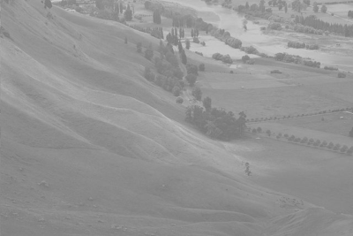
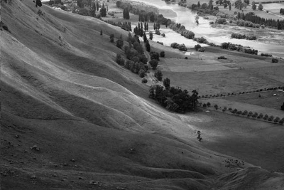
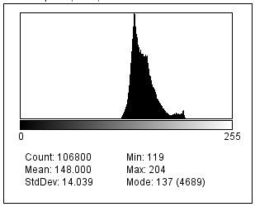
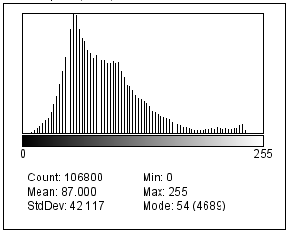
Image enhancement Histogram
Low contrast, low dynamic range
Medium contrast, high dynamic range
Source: By original Phillip Capper, modified by User:Konstable - modified Hawkes Bay NZ.jpg, CC BY 2.0, https://commons.wikimedia.org/w/index.php?curid=855363

Slide 11
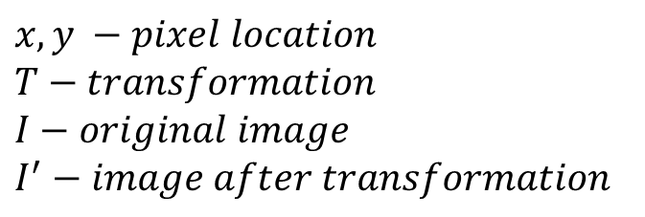

Image enhancement Histogram manipulations
Aim : to “redistribute” the histogram so that contrast and dynamic range may be enhanced.
General principles
The only information used is the statistics of image values (referred to as statistical image model)
The same transformation is applied to each pixel (referred to as pixel point processing)
Mathematical notation
$$x,y −pixel location$$
$$T−transformation$$
$$I−original image$$
$$I^{′}−image after transformation$$
$$I^{′}\left(x,y\right)=T ( I\left(x,y\right) )$$

Slide 12
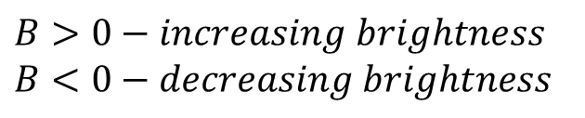

Image enhancement Histogram manipulations: shifting
The effect on the image: lightning or darkening.
The effect on the histogram: shifted to the right or left from that of the original.
The operation: adding or subtracting a constant value to all pixels.
Mathematical notation:
$$I^{′}\left(x,y\right)= I\left(x,y\right)+B$$
$$B>0−increasing brightness$$
$$B<0−decreasing brightness$$

Slide 13

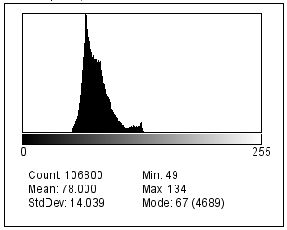

Image enhancement Histogram manipulations: shifting
$$I^{′}= I−70$$

Slide 14
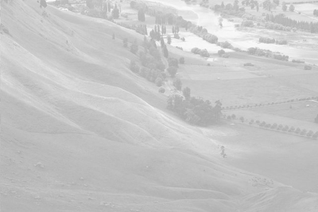
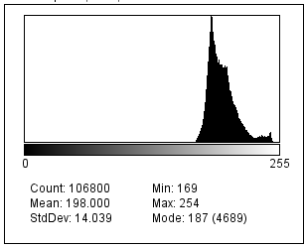

Image enhancement Histogram manipulations: shifting
$$I^{′}= I+50$$

Slide 15
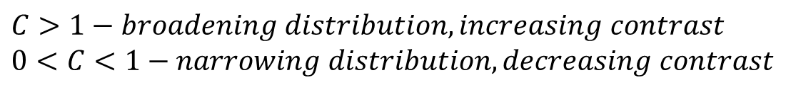

Image enhancement Histogram manipulations: stretching
The effect on the image: changing contrast and / or dynamic range.
The effect on the histogram: broader or narrower distribution in relation to that of the original.
The operation: multiplying all pixels by a constant value.
Mathematical notation:
$$I^{′}\left(x,y\right)=C∙I\left(x,y\right)$$
$$C>1−broadening distribution, increasing contrast$$
$$0<C<1−narrowing distribution, decreasing contrast$$

Slide 16
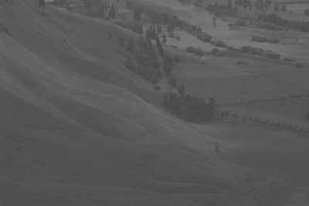
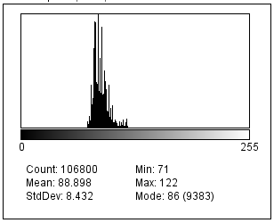

Image enhancement Histogram manipulations: stretching
$$I^{′}=0.65∙I$$

Slide 17
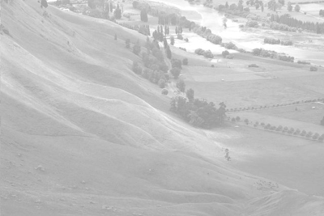
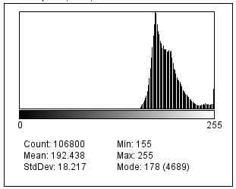

Image enhancement Histogram manipulations: stretching
$$I^{′}=1.25∙I$$

Slide 18
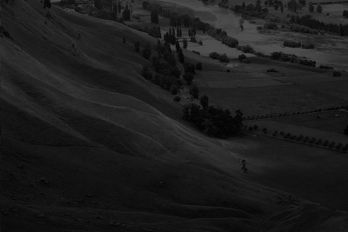
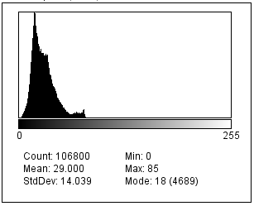



Image enhancement Histogram manipulations: shift and stretch
$$I^{′}=I−119$$
$$I^{′′}=3∙I′$$
$$I^{′}=3∙(I−119)$$

Slide 19
Image enhancement Histogram manipulations: equalisation
The effect on the image: visually enhancing dynamic range, e.g. lightening underexposed areas, darkening overexposed areas.
The effect on the histogram: image values distributed across the whole range, spaced in proportion to the number of pixels with a given value in the original.
The operation: applying the inverse of the cumulative histogram (histogram’s probability distribution function, pdf).
Mathematical notation:
See Histogram equalization in the list of further readings

Slide 20
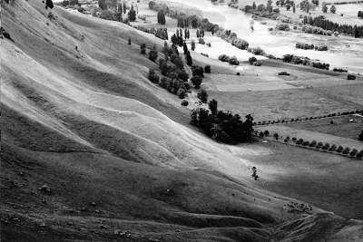
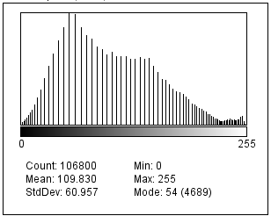
Image enhancement Histogram manipulations: equalisation

Slide 21

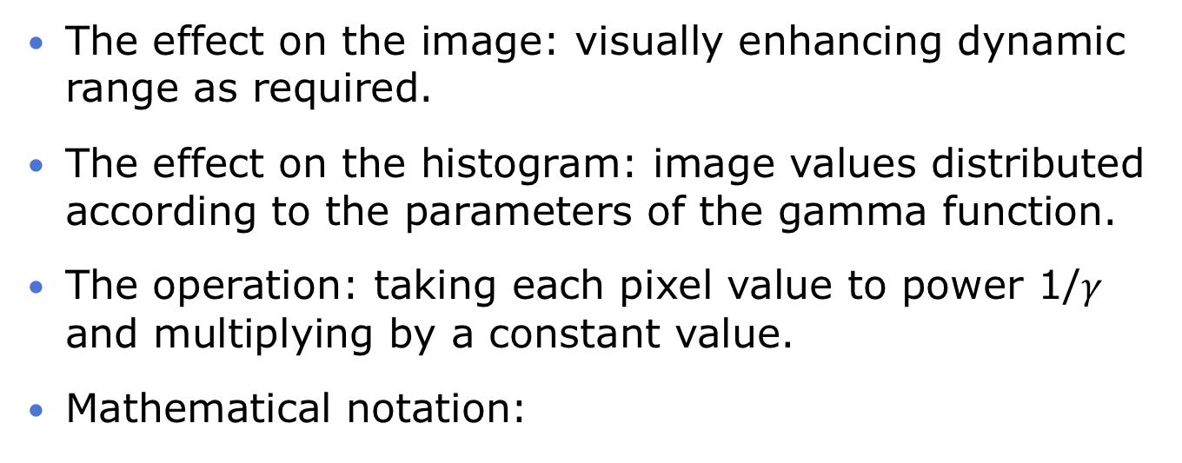
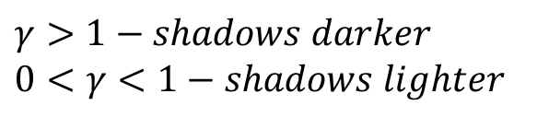
Image enhancement Histogram manipulations: gamma correction
The effect on the image: visually enhancing dynamic range as required.
The effect on the histogram: image values distributed according to the parameters of the gamma function.
The operation: taking each pixel value to power 1/$γ$ and multiplying by a constant value.
Mathematical notation:
$$I^{′}\left(x,y\right)={C∙I\left(x,y\right)}^{1/γ}$$
$$γ>1−shadows darker$$
$$0<γ<1−shadows lighter$$

Slide 22

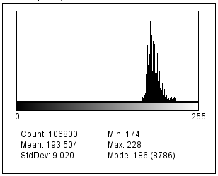


Image enhancement Histogram manipulations: gamma correction
$$γ=0.5$$
$$I^{′}={1∙I}^{2}$$

Slide 23
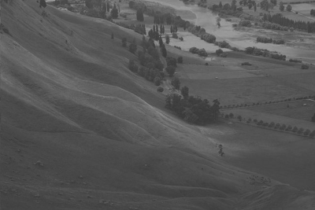
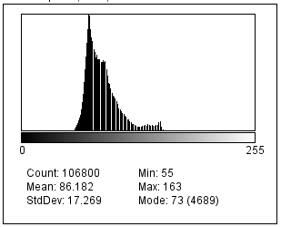


Image enhancement Histogram manipulations: gamma correction
$$γ=2$$
$$I^{′}={1∙I}^{0.5}$$

Slide 24
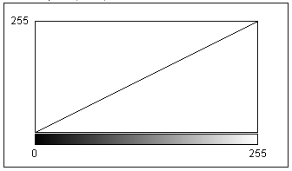
Image enhancement LUT operations
Indexed colour (see previous lecture)
A pixel value (or a value of a pixel component) is an index (a pointer) to a table containing colour definitions
Pixel colour values
Pixel image values

Slide 25
Image enhancement LUT operations
Instead of manipulating pixel values, we can manipulate the contents of the LUT.
The same results can be achieved but much faster.
On a 1,000x1,000 image (1,000,000 pixels) with 256 grey levels
Using operations on pixel values: million operations
Using operations on LUT: 256 operations

Slide 26
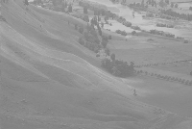


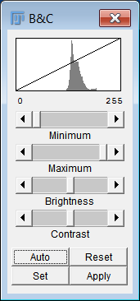
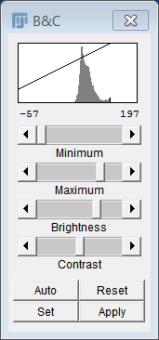
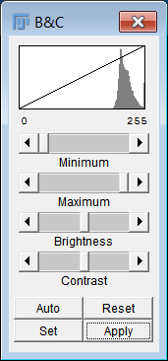
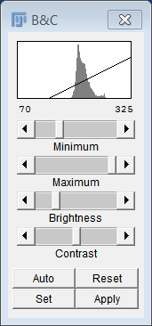
Image enhancement LUT operations (equivalent to histogram shift)
Original mapping
Change LUT
Apply LUT

Slide 27
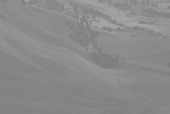
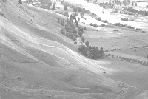
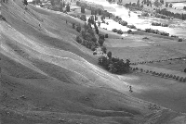
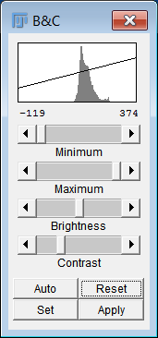
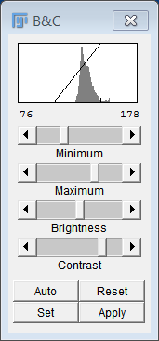

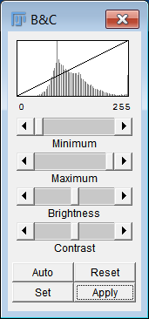
Image enhancement LUT operations (equivalent to histogram stretch)
Change LUT
Apply LUT

Slide 28
In this lecture we have covered:
Improving image quality
Manipulating image brightness
Contrast enhancement
Image histogram
LUT operations

Slide 29
Next lecture:
Common types of image corruption
Noise
Blur
Image frequencies
Tools and methods for noise removal
Image profile
Image filtering operations
Convolution
Low-pass (smoothing) filters

Slide 30
Further reading and experimentation
Book chapters
Sonka, M. Hlavac, V. Boyle, R. (various editions) Image Processing, Analysis and Machine Vision, Chapman & Hall Computing, 4.1
Gonzalez, R.C. & Woods, R.E. (various editions) Digital Image Processing, Addison-Wesley, Ch. 4.
Contrast enhancement
http://micro.magnet.fsu.edu/primer/digitalimaging/russ/expandingcontrast.html
http://micro.magnet.fsu.edu/primer/digitalimaging/imageprocessingintro.html
Histogram equalization www.math.uci.edu/icamp/courses/math77c/demos/hist_eq.pdf
Gamma correction: http://www.cambridgeincolour.com/tutorials/gamma-correction.htm
https://ledshield.wordpress.com/2012/11/13/led-brightness-to-your-eye-gamma-correction-no/
http://www.dfstudios.co.uk/articles/programming/image-programming-algorithms/image-processing-algorithms-part-6-gamma-correction/

